Slide 1
END – TERM PRESENTATION
REAL TIME OBJECT DETECTION
Presented by
Under the Supervision of
Dr. Roohi Sille
Assistant Professor (SG)
CSO Cluster, SOCS
Suvayan Chatterjee
Sap_ID : 500123479
M.Tech Computer Science and Engineering

Slide 2
Content
Abstract
Introduction
Literature Review
Problem Statement
Methodology
Conclusion
Future Scope
References

Slide 3
Abstract
This project develops a real-time object detection system using the TensorFlow Object Detection API, starting with manual image collection. Images are captured and labeled with bounding boxes to create a custom dataset, using tools like Labeling. Pre-trained models such as SSD MobileNet are fine-tuned on this dataset through transfer learning, improving training efficiency and accuracy.
After training, the model is evaluated using metrics like mean Average Precision (mAP) and Intersection over Union (IoU) to ensure it generalizes well. The system is then deployed for real-time detection on live video streams, identifying and tracking objects with bounding boxes and labels. Optimizations such as data augmentation and hyperparameter tuning are applied to enhance detection performance. This process provides an efficient, accurate object detection solution, applicable in diverse real-world scenarios.

Slide 4
Introduction
Real-time object detection is a critical task in computer vision that involves identifying and classifying objects in images or videos as they appear in real-time. Using TensorFlow, an open-source machine learning framework, object detection models can be trained to recognize a wide range of objects from pre-defined categories. TensorFlow's Object Detection API simplifies the implementation of complex models such as SSD (Single Shot Multibox Detector) and Faster R-CNN, which are capable of detecting multiple objects in an image with high accuracy and speed.
The process typically involves training a model using labeled datasets, which contain images annotated with object locations. Once trained, the model can be deployed to detect objects in real-time applications such as autonomous driving, surveillance systems, and gesture recognition. TensorFlow’s flexibility and robust performance make it an ideal choice for building real-time detection systems that require both speed and precision.

Slide 5
Literature Review
Reference | Technique | Dataset | Performance | Advantage | Disadvantage
[2] | YOLOV1 | Pascal VOC 2007/2012 | 65..7% and 58% | Enhancedloss function improves detection | Detection accuracy still struggles, especially with small objects.
[4] | 1.Single Shot Detector (SSD) algorithm 2.MobileNets algorithm | COCO | 99% | SSD achieves high accuracy, optimizing bounding box error enhances it further. | Single-shot detectors like SSD can struggle with detecting small objects compared to two-stage detectors.
[5] | VGG 16 SSD | Covid19 | 78.6% | YOLO achieve a balance between speed, simplicity, and accuracy while providing performance, averaging 155 FPS with a mAP of 78.6. | YOLOv2 has dependence on high-quality training data, which could delay further improvements in accuracy.

Slide 6
Literature Review
[7] | 1.YOLO 2.( Region-based Fully Convolutional Networks)RFCN | KITTI | 83.4% | Enhances YOLO’s speed by 18% with improved accuracy. | YOLO- Even with its increased speed, it might still need a lot of computational power. R-FCN-low in accuracy(67.7%mAP).
[8] | 1.OYOLOv3 2.RFCN | KITTI | 86.4% | YOLO provides an exceptional balance between speed and accuracy | Due to its grid-based prediction approach, which limits the number of bounding boxes it can generate per grid cell.
[9] | Nvidia Jetson AGX Xavier YOLO | KITTI, COCO | YOLO v3 by 76% and the 99th percentile delay by 67% on an Nvidia Jetson AGX Xavier | The suggested changes to improve the responsiveness of autonomous driving systems by reducing end-to-end delays by 76%. | For guaranteeing safety in autonomous driving applications, the study only considers average delays.

Slide 7
Literature review
[10] | YOLOV4(2D) Pointpiller(3D) | COCO KITTI | 85% | framework enables efficient real-time object detection on mobile devices. | The reliance on specific pruning schemes may limit the generalizability of the framework .
[11] | CNN | PETA–CUHK Dataset INRIA DataSet | 98 | High recognition accuracy (up to 100%) . tailored optimizations that may enhance performance compared to standard modules. | Building from scratch is time-consuming and may underperform.

Slide 8
Problem Statement
Object detection is a critical task in computer vision that involves identifying and locating objects within images or video frames. Despite significant progress in the field, developing an efficient and accurate object detection system remains challenging due to the need for large annotated datasets, computational resources, and the complexity of tuning hyperparameters. The specific problem addressed in this project is to develop a robust object detection system using TensorFlow that can achieve high accuracy and real-time performance while being adaptable to various real-world applications.

Slide 9
Methodology
1.Framework and Tools
Framework: TensorFlow
Model: SSD MobileNet (Single Shot Detector with MobileNet backbone)
Tools Used:
TensorFlow Object Detection API.
Pre-trained SSD MobileNet model from TensorFlow Model Zoo.
OpenCV for handling real-time video feeds.

Slide 10
Methodology
2.Workflow
Image Collection Collect diverse images representing objects to detect.
Data Annotation Use tools like LabelImg to label images with bounding boxes and save annotations.
Create Label Map and TFRecord
Define a label map linking class IDs to class names.
Convert annotated data to TFRecord format for TensorFlow.
Configure Model for Training
Download a pre-trained SSD MobileNet model.
Modify the pipeline.config file to link training data, label map, and model parameters.
Train the Model Train using the TensorFlow Object Detection API:

Slide 11
Methodology
Evaluate the Model
Assess the model's performance using validation data (mAP, loss curves).
Export Trained Model Save the trained model as saved_model for inference:
Detect Objects
Load the model.
Use real-time data (e.g., from a webcam) or static images for detection.
Visualize results with bounding boxes, labels, and scores.

Slide 12
Methodology
3.Architecture
SSD MobileNet Overview
SSD (Single Shot Detector):
Performs object localization and classification in a single forward pass.
Uses default bounding boxes for detecting objects at various scales.
MobileNet Backbone:
Lightweight CNN optimized for mobile and embedded devices.
Uses depthwise separable convolutions for efficiency.
Input and Output
Input:
Images or video frames (shape: [1, height, width, 3]).
Output:
Bounding box coordinates.
Class labels.
Confidence scores.

Slide 13
Methodology
4.Advantages of SSD MobileNet
Real-Time Performance: Achieves high-speed inference suitable for real-time applications.
Lightweight: Optimized for resource-constrained devices.
Scalable: Can be deployed on edge devices using TensorFlow Lite.

Slide 14
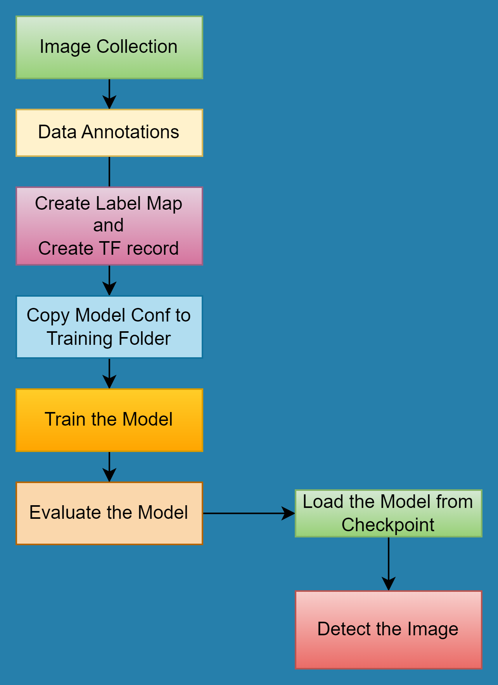
Methodology

Slide 15
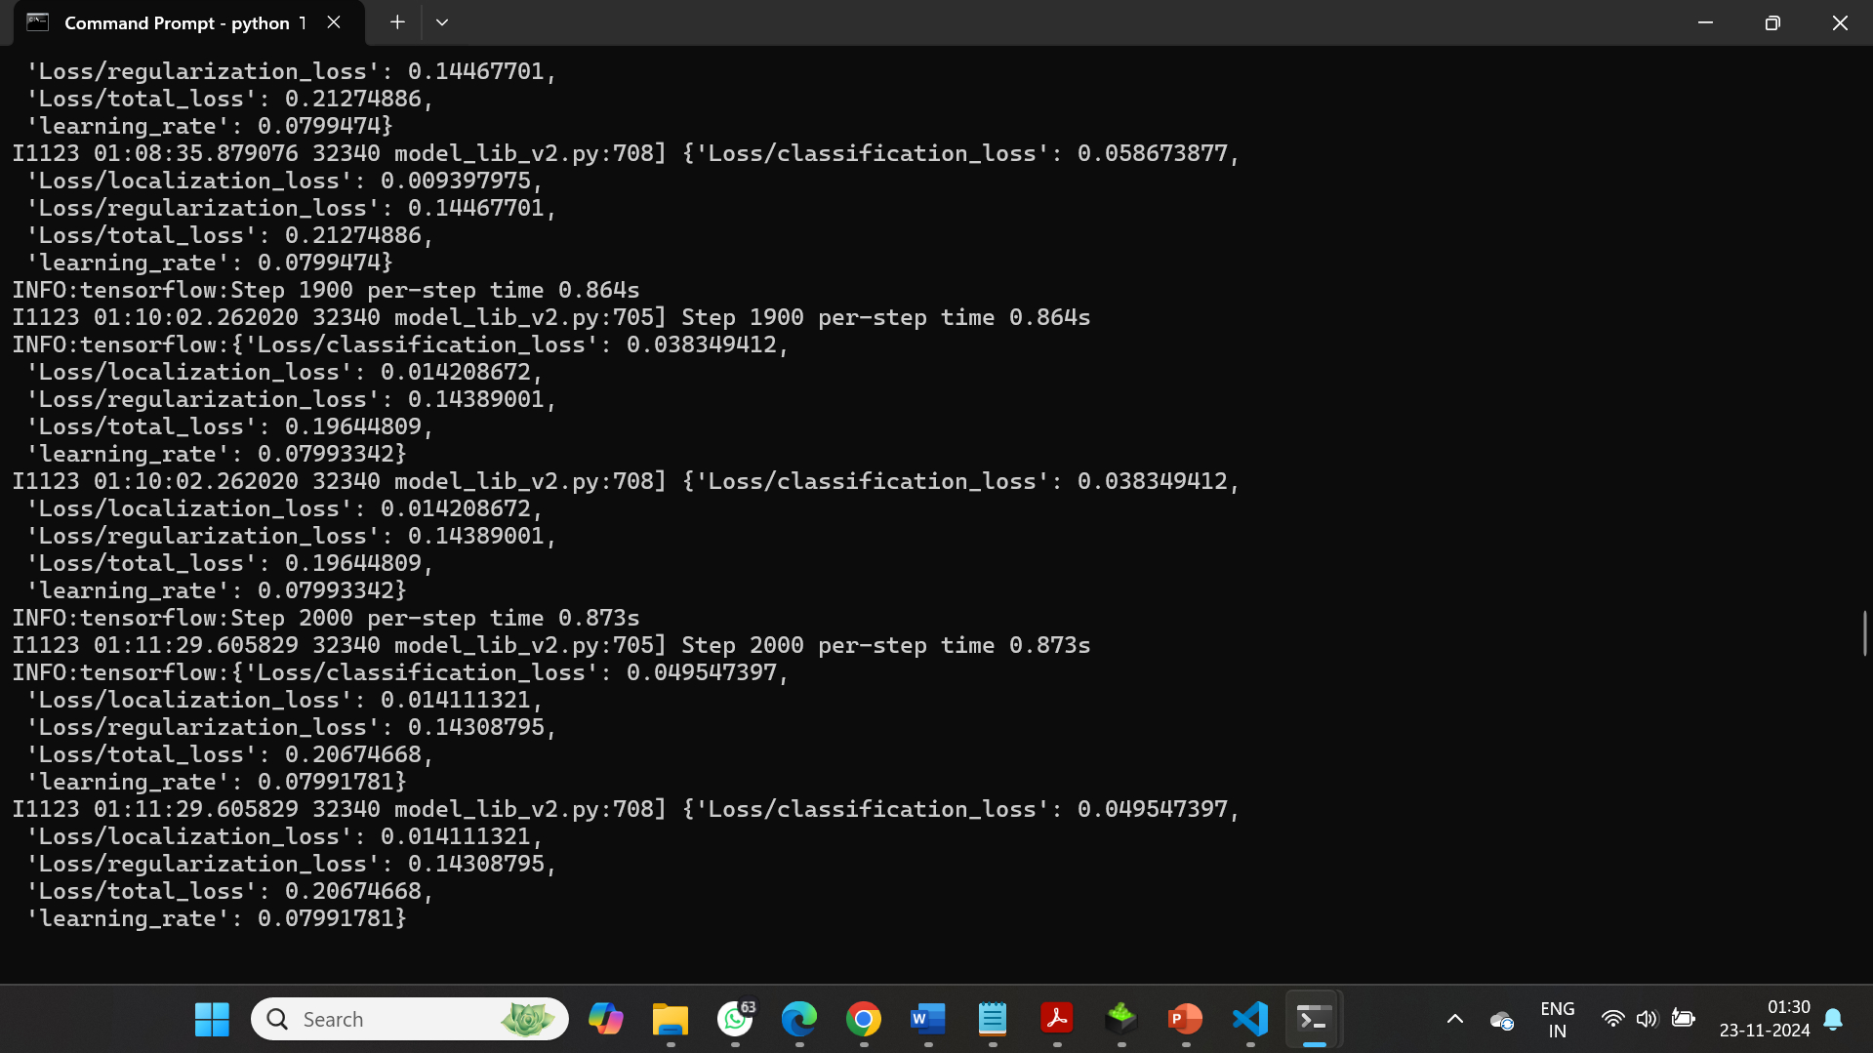
Loss Function after 2000 training steps

Slide 16
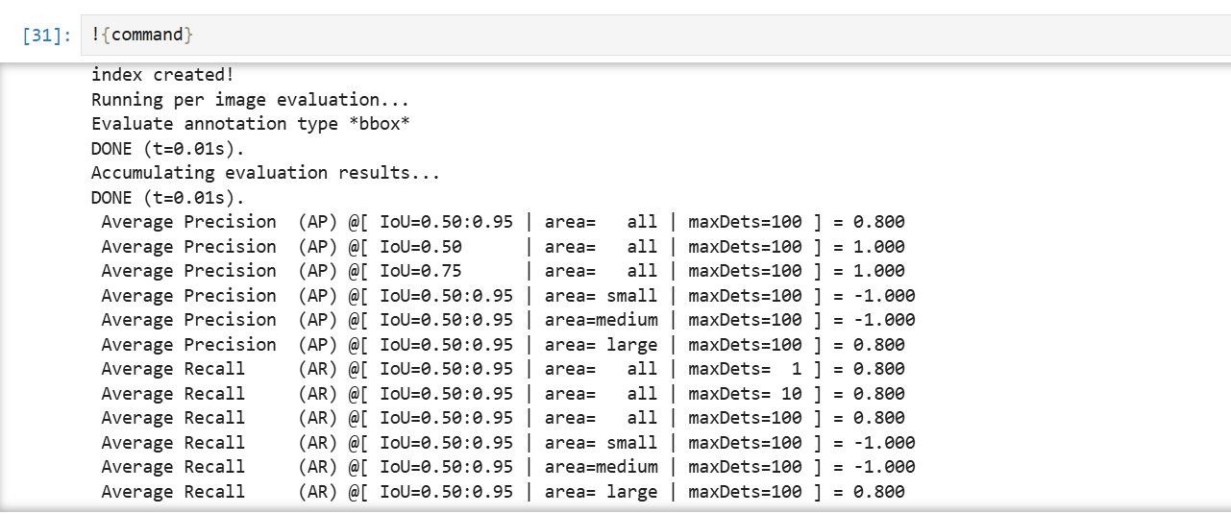
Average precision

Slide 17
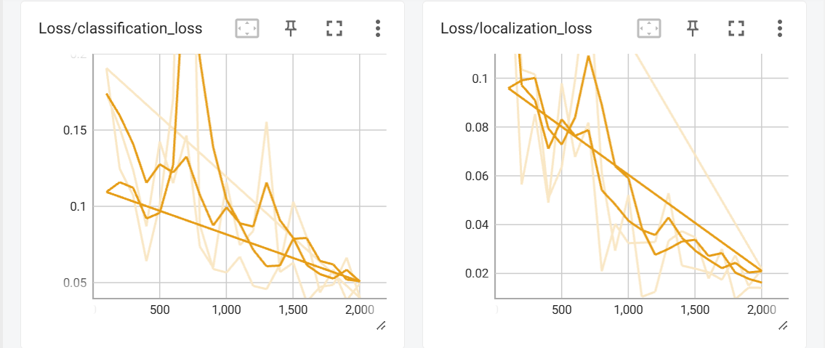
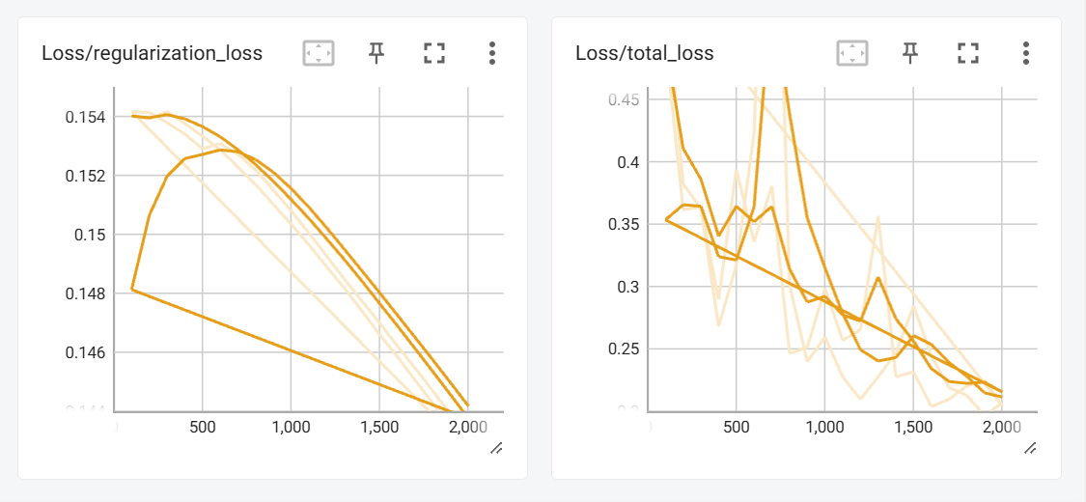
Loss Function

Slide 18
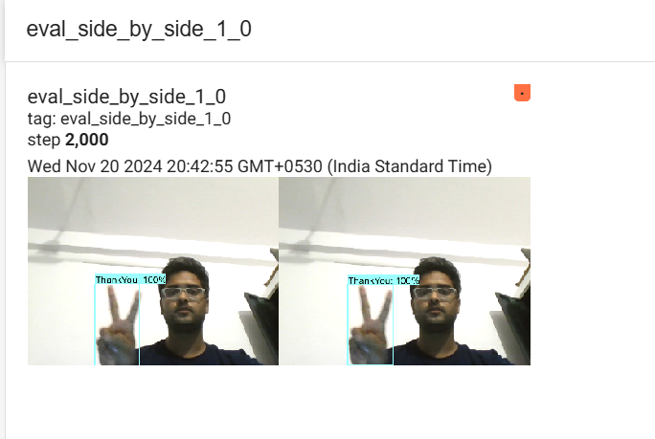
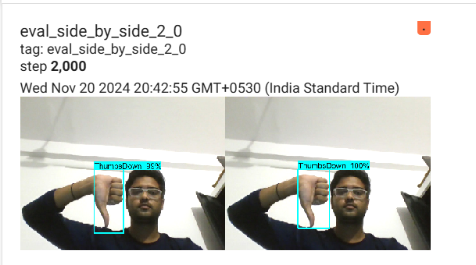
Result
Fig1. Accuracy of the Image showing “ThankYou” is 100%
Fig2.Accuracy of the Image showing “ThumbsDown” is between 99% and 100%.

Slide 19
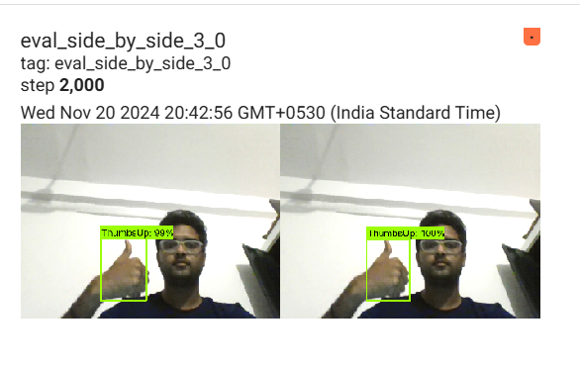
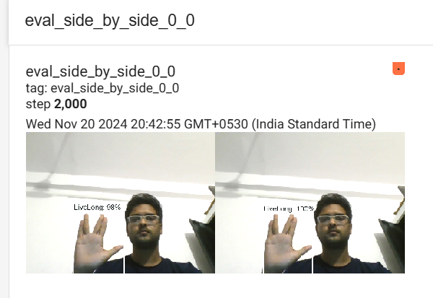
Result
Fig3. Accuracy of Image showing “Thumsup” is between 99% and 100%.
Fig4.Accuracy of Image showing “LiveLong” is between 99% and 100%

Slide 20
Conclusion
The TensorFlow Object Detection Course project offers a comprehensive and practical guide to developing an object detection system. By leveraging TensorFlow and Jupiter Notebooks, the project provides valuable experience in image collection, model training, and real-time detection, paving the way for future advancements in computer vision and artificial intelligence.

Slide 21
Future Scope
Autonomous Vehicles
Security and Surveillance
Augmented Reality (AR) and Virtual Reality (VR)
Healthcare
Retail and E-commerce

Slide 22
References
Reference
[1] M. - and H. Ravish, “Object Detection and Tracking using Deep Learning and Artificial Intelligence for
Video Surveillance Applications,” IJACSA, vol. 10, no. 12, 2019, doi: 10.14569/IJACSA.2019.0101269.
[2] T. Ahmad, Y. Ma, M. Yahya, B. Ahmad, S. Nazir, and A. U. Haq, “Object Detection through Modified
YOLO Neural Network,” Scientific Programming, vol. 2020, pp. 1–10, Jun. 2020, doi: 10.1155/2020/8403262.
[3] J. Tao, H. Wang, X. Zhang, X. Li, and H. Yang, “An object detection system based on YOLO in traffic
scene,” in 2017 6th International Conference on Computer Science and Network Technology (ICCSNT), Dalian,
China: IEEE, Oct. 2017, pp. 315–319. doi: 10.1109/ICCSNT.2017.8343709.
[4] G. Chandan, A. Jain, H. Jain, and Mohana, “Real Time Object Detection and Tracking Using Deep
Learning and OpenCV,” in 2018 International Conference on Inventive Research in Computing Applications
(ICIRCA), Coimbatore: IEEE, Jul. 2018, pp. 1305–1308. doi: 10.1109/ICIRCA.2018.8597266.
[5] J. Du, “Understanding of Object Detection Based on CNN Family and YOLO,” J. Phys.: Conf. Ser., vol.
1004, p. 012029, Apr. 2018, doi: 10.1088/1742-6596/1004/1/012029.
[6] T. Diwan, G. Anirudh, and J. V. Tembhurne, “Object detection using YOLO: challenges, architectural
successors, datasets and applications,” Multimed Tools Appl, vol. 82, no. 6, pp. 9243–9275, Mar. 2023, doi:
10.1007/s11042-022-13644-y.
[7] “Tao et al. - 2017 - An object detection system based on YOLO in traffi.pdf.”

Slide 23
References
[8] “Du - 2018 - Understanding of Object Detection Based on CNN Fam.pdf.”
[9] W. Jang, H. Jeong, K. Kang, N. Dutt, and J.-C. Kim, “R-TOD: Real-Time Object Detector with Minimized
End-to-End Delay for Autonomous Driving,” in 2020 IEEE Real-Time Systems Symposium (RTSS), Houston,
TX, USA: IEEE, Dec. 2020, pp. 191–204. doi:
10.1109/RTSS49844.2020.00027.
[10] “Zhao et al. - 2021 - Neural Pruning Search for Real-Time Object Detecti.pdf.”
[11] K. Pranav and J. Manikandan, “Design and Evaluation of a Real-time Pedestrian Detection System for
Autonomous Vehicles,” in 2020 Zooming Innovation in Consumer Technologies Conference (ZINC), Novi Sad, Serbia: IEEE, May 2020, pp.
155–159. doi:10.1109/ZINC50678.2020.9161768.

Slide 24
THANK YOU

